Slide 1

Power Query Task: Data Cleaning & Analysis

Slide 2







Our Team
Project Overview: From Raw to Refined
Lateefah Abdur-Rahman
Hauwa Dauda Atta
Jimoh Abdur-Rahman
Damilare
Oluwajuwonlo
Toyyib Olalekan

Slide 3
OUTLINE
Bashir Aminat
Lateefah Abdur-Rahman
Hauwa Dauda Atta
Jimoh Abdur-Rahman
Damilare
Oluwajuwonlo
Toyyib Olalekan

Slide 4

Project Overview: From Raw to Refined
This project demonstrates a comprehensive data cleaning, transformation, and analysis process using Power Query, Excel, and Power BI. We tackle a "dirty" dataset to extract valuable insights.

Slide 5
The Challenge: "Dirty" Amazon Sales Data
The Amazon International Apparel Sales Data, with 37,432 rows, presented significant challenges:
Missing Values
Categorical Chaos
Formatting Issues
1,040 rows lacked transactional data; 2,474 rows missed critical SKU information.
The 'Size' column was inconsistent: alphabetical, numeric, outliers (600, 1000), and special labels.
Trailing punctuation, concatenation errors, and excessive whitespace plagued SKU and Size fields.

Slide 6

More Data Quality Issues
1
2
Redundancy & Logic Errors
Data Corruption
Half of the DATE column failed standard parsing, indicating mixed MM/DD vs. DD/MM formats.
Index and Months columns were redundant; GROSS AMT had rounding issues; DATE column showed mixed formats.
3
Structural Inconsistencies
The dataset was effectively multiple tables merged, requiring separation and re-integration.

Slide 7

Cleaning Process: Initial Steps in Power Query
The cleaning began by importing the CSV into Power BI and transforming the data in Power Query.
Separated the original dataset into two distinct tables based on index ranges.
Forced date column datatype to recognize mixed formats (MM/DD vs DD/MM).
Deleted redundant 'Month' and 'Stock' columns.

Slide 8
Advanced Cleaning & Transformation
01
02
03
SKU Reconstruction
Table Alignment
Size Extraction
Used CONCATENATE to fill missing SKUs by combining 'Style' and 'Size' columns.
Rearranged columns in the second table to match the first; ensured consistent font casing.
Added a 'Size' column to the second table by extracting text after delimiters in the SKU column.
04
05
Append & Standardize
Duplicate Removal
Appended the two cleaned tables; standardized font cases and corrected values across the merged dataset.
Removed duplicate records using 'Date', 'Customer', and 'SKU' as reference keys.

Slide 9

Building a Date Table for Analysis
After cleaning, a dedicated date table was created in Power BI to facilitate time-based analysis.
Created 'DateTable' using CALENDARAUTO().
Generated new columns for 'Month', 'Day of the Week', and 'Year'.
This enables calculation of revenue and sales per month/year.

Slide 10

Key Insights Post-Cleaning
Customer Concentration
80/20 Product Rule
Top 5% of customers drive 72.4% of total revenue, highlighting reliance on key accounts like MULBERRIES BOUTIQUE.
Only 168 styles account for 81% of revenue, showing a significant Pareto distribution in inventory.
Size Dominance
Seasonal Volatility
Extreme sales peaks in June and September 2021 suggest specific high-volume turnover windows.
Mid-range sizes (L, XL, M) dominate over 65% of sales volume, indicating skewed market demand.

Slide 11

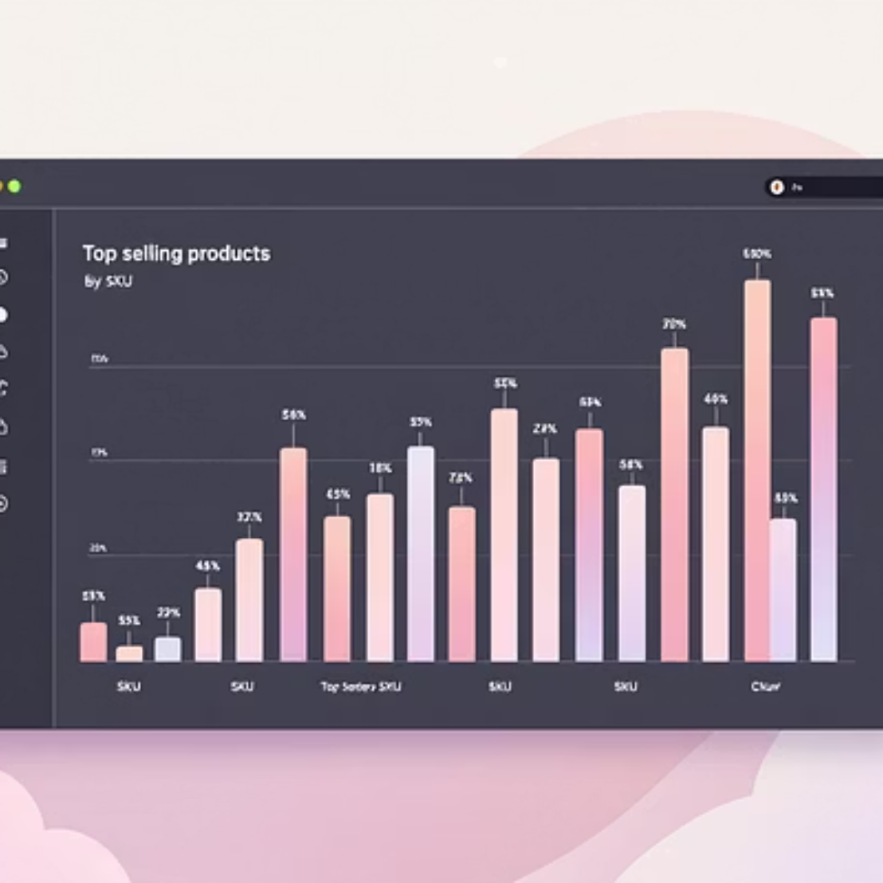

Analysis in Power BI: Visualizing Performance
The cleaned data was loaded into Power BI, enabling detailed analysis of sales and financial performance.

Slide 12
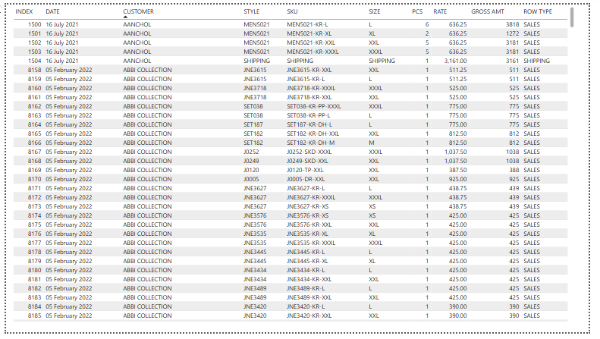
Analysis in Power BI: Visualizing Performance

Slide 13
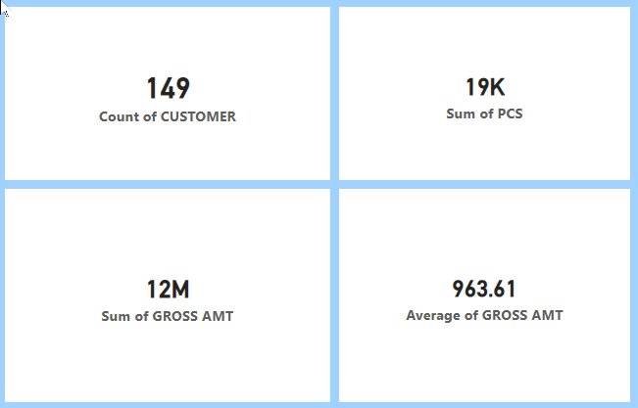
Analysis in Power BI: Visualizing Performance

Slide 14
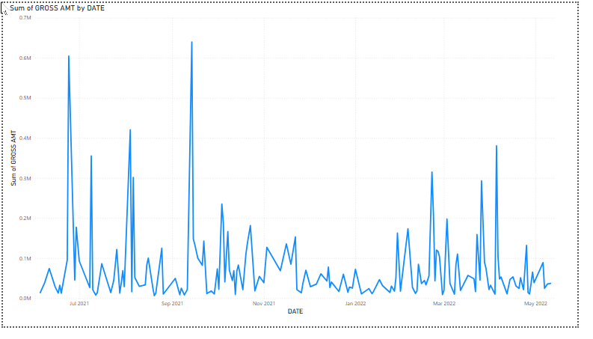
Analysis in Power BI: Visualizing Performance

Slide 15
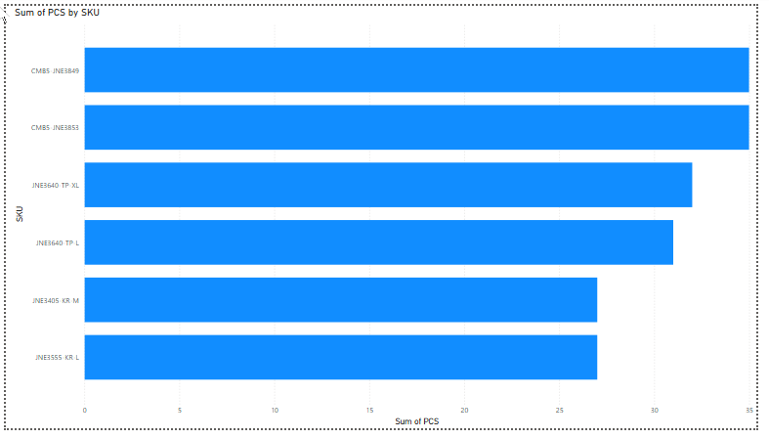
Analysis in Power BI: Visualizing Performance

Slide 16
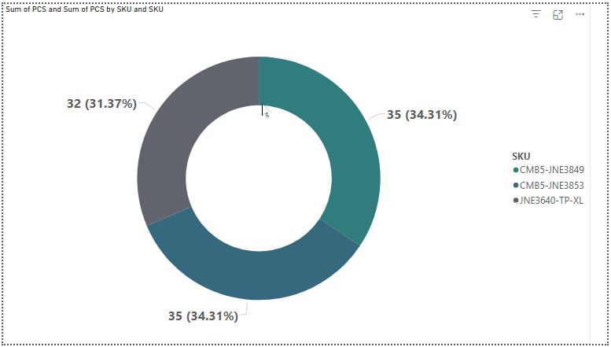
Analysis in Power BI: Visualizing Performance

Slide 17
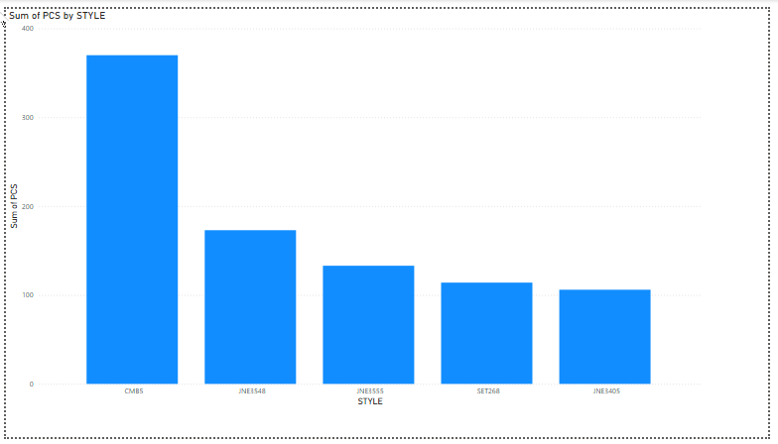
Analysis in Power BI: Visualizing Performance

Slide 18
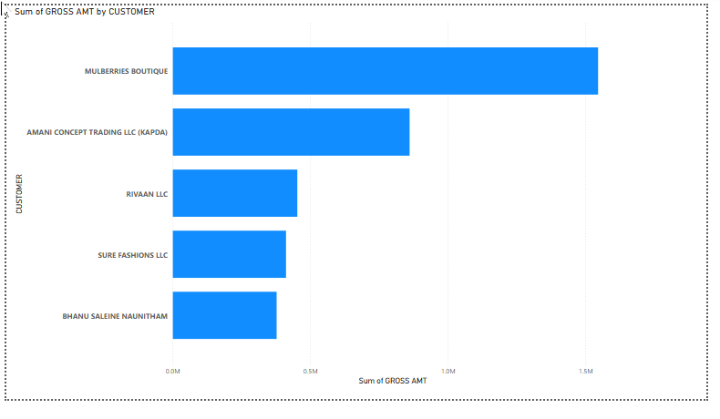
Analysis in Power BI: Visualizing Performance

Slide 19

Conclusion: From Chaos to Clarity
The extensive data cleaning transformed an unusable dataset into a high-fidelity resource for decision-making. Future data collection should implement strict schema validation to prevent similar "categorical chaos" and structural shifts.

Slide 20


